Slide 1

“Performance evaluation of varied KPIs in dynamic RAN slice of 5G Network”
Team No: N20
Name | USN
Pragathi Pujari | 01FE20BCS189
B Ajay Kushal | 01FE20BCS289
Lavanya Shahapur | 01FE20BCS185
Kushagra Tomar | 01FE20BCS063
Ashwini Jannu | 01FE20BCS208
Guided by
Mr.Parikshit P Hegde

Slide 2

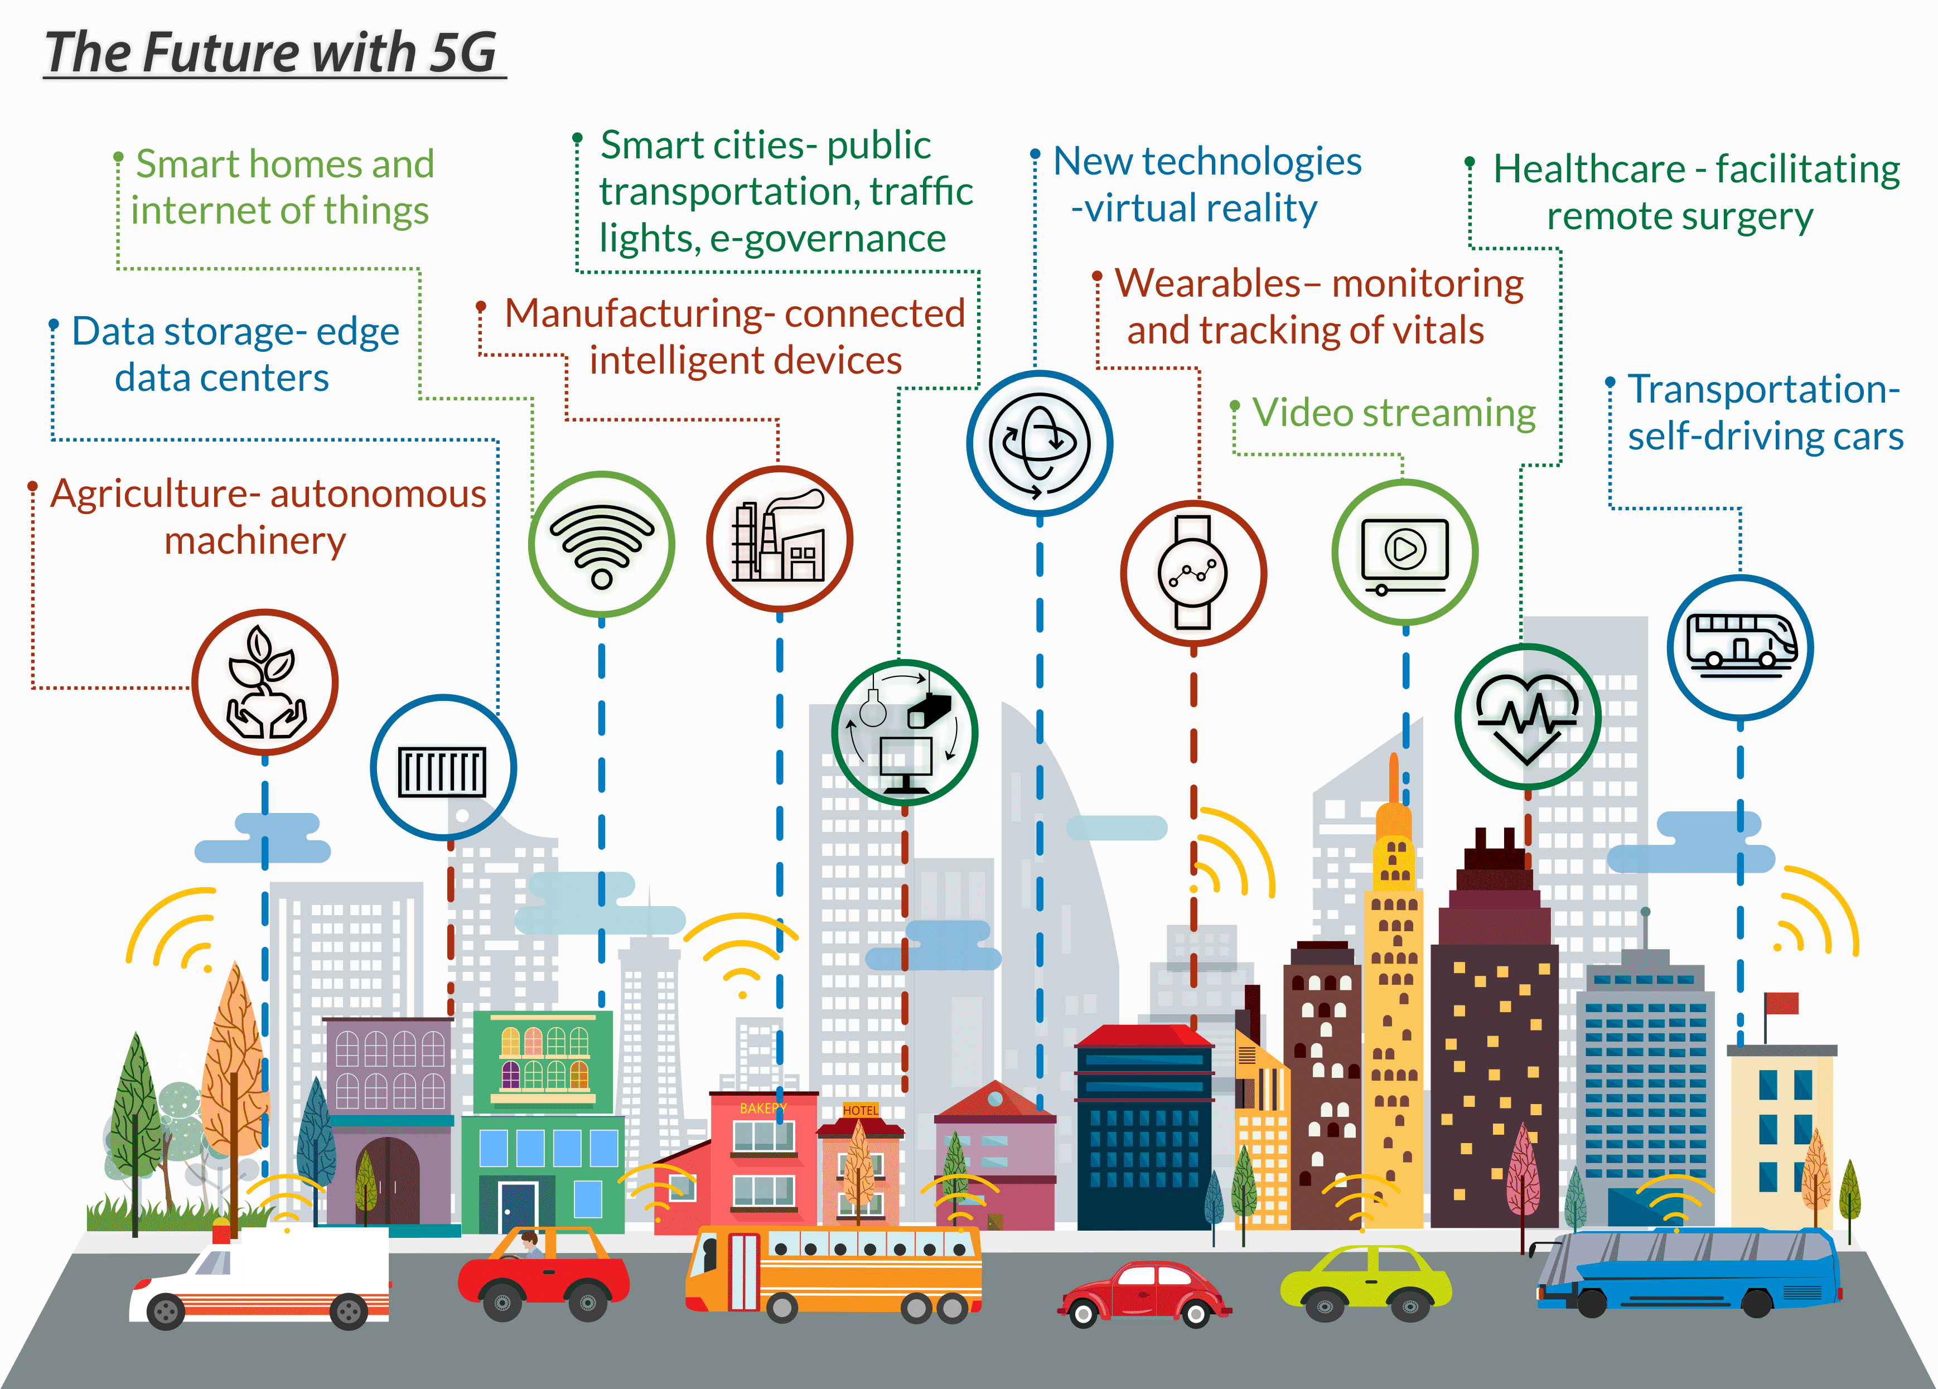
Introduction: 5G Network
Fifth-generation wireless networks are to bring a major transformation to the current fourth-generation network by supporting billions of devices that will be connected to the Internet and by providing higher data speeds, ultra low latency, more reliability, and massive network capacity.

Slide 3
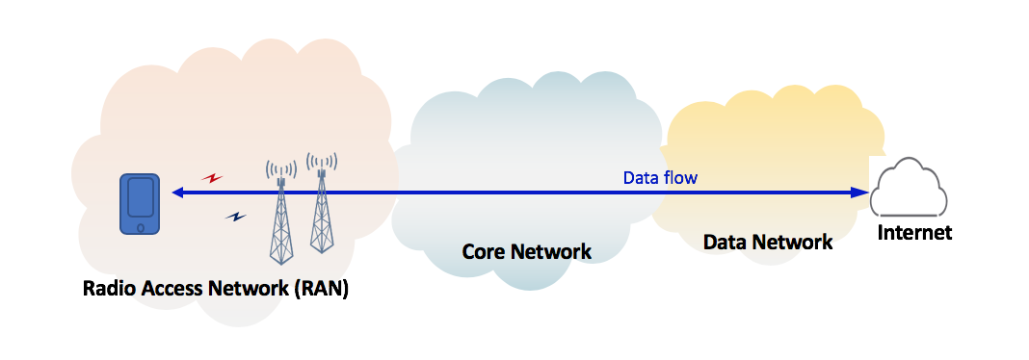
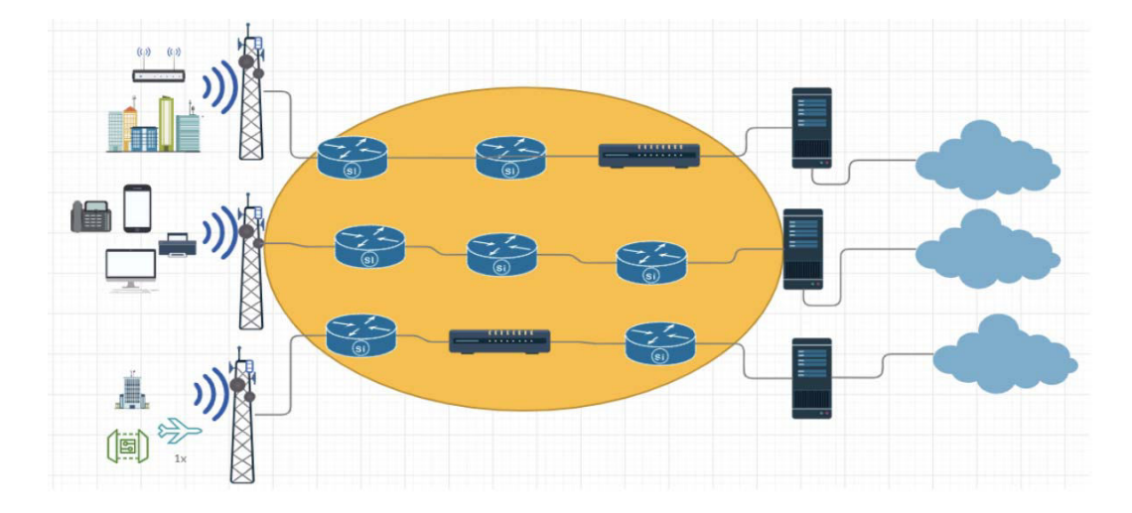
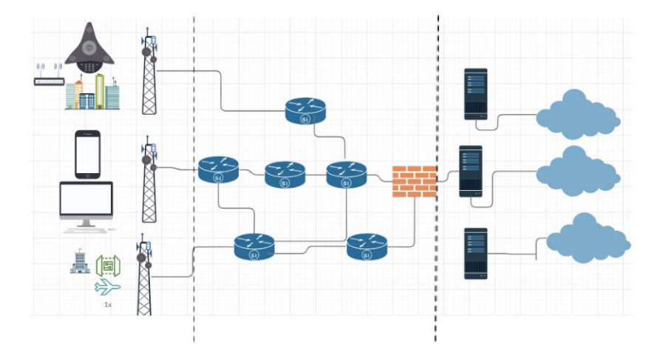
Introduction: 5G Network Slicing
The 3GPP has recognized network slicing to be an essential overall component of 5G. This has made slicing an ongoing focus for working groups developing 5G core architecture.
A 5G network slicing can be performed across Radio Access Network (RAN), Core Network (CN), and Cloud network.

Slide 4
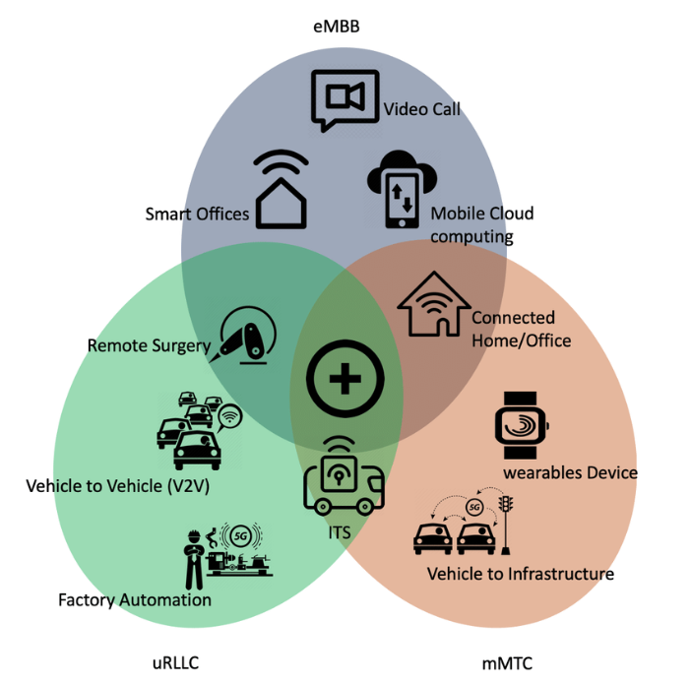
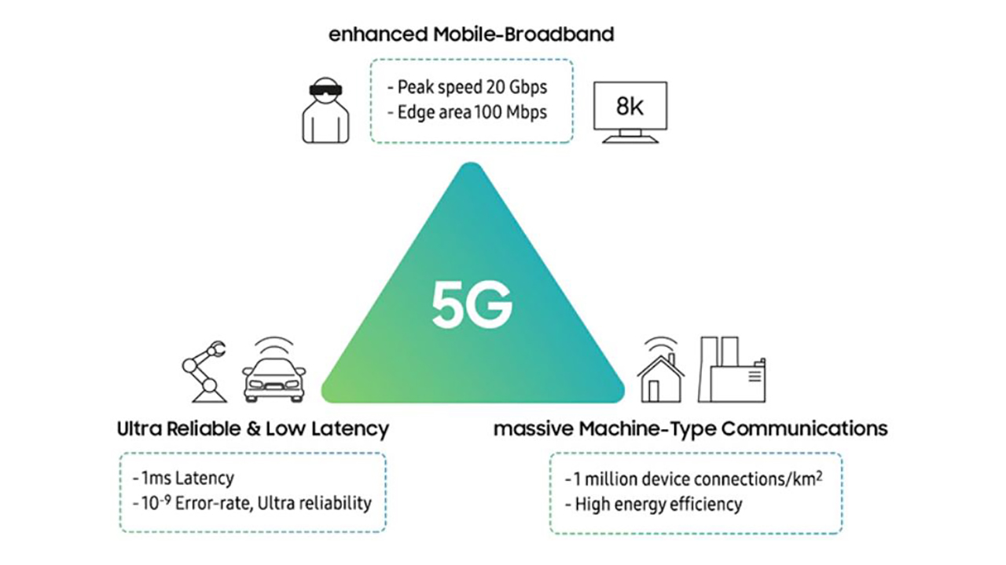
Introduction: 5G Network
5G provides network slicing as a fundamental capability, whereas 4G and earlier generations of cellular data services could not support network slicing.
Slicing this network enables the network operator to maximize the usage of network resources and allow service flexibility.
Network slicing enables the network to efficiently address all three use cases.

Slide 5
Problem Statement
“Performance evaluation of varied Key Performance Indicators (KPIs)
in dynamic Radio Access Network(RAN) slice environment of 5G”
Supports multiple logical networks over common infrastructure.
To evaluate KPI’s with respect to the different use cases.
To design and customize the network slices to meet the demands of all use cases dynamically.

Slide 6

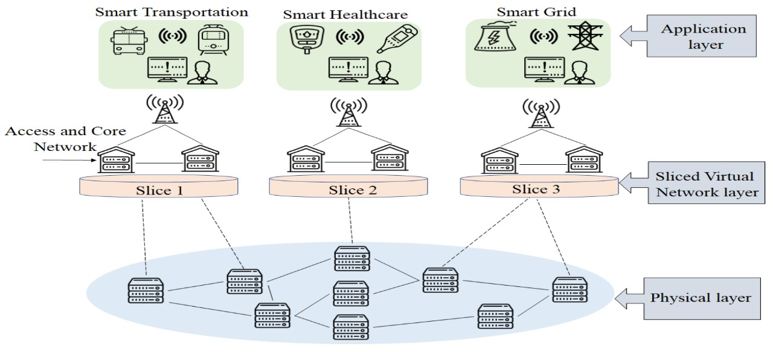
Motivation : 5G RAN Slicing
It is the key factor to optimise 5G network so that they efficiently address all the three use cases.
This area needs more attention and still more research is needed.
Static slicing lacks in dynamically allocating resource.
Dynamically create new slice, deploying service on pre-existing slice, and customize slices.

Slide 7
Objectives / Goals
To simulate dynamic slicing of 5G RAN to meet the needs and requirements of different use cases.
To evaluate the performance of KPIs of 5G RAN slicing.
To simulate resource allocation with tailored solutions to separate slices.

Slide 8
Scope and Constraints
Scope
Smart cities
Smart grids
Autonomous Vehicles
Medicine, Healthcare, and Telesurgery
Constraints
Expensive to setup
Lack of physical equipment
Different use cases have different requirements
KPIs – network energy efficiency , spectrum efficiency etc.

Slide 9

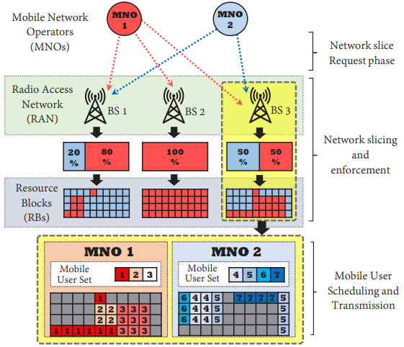
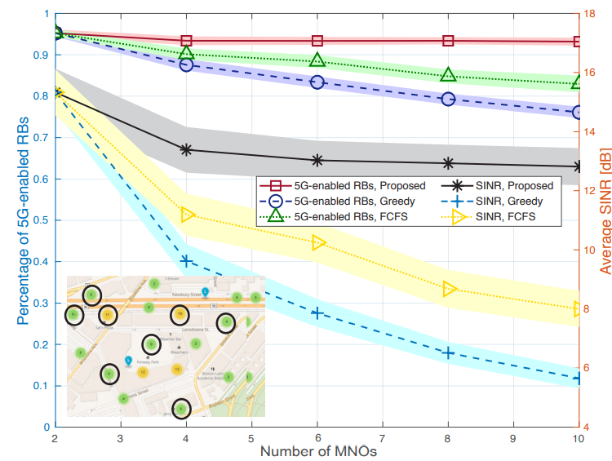
Toward Operator-to-Waveform 5G Radio Access Network Slicing
Link to the Paper
Methodology
Introduction
Radio access network (RAN) slicing is expected to be a pivotal component of next-generation 5G networks [1] and the Internet of Things [2, 3]. By leveraging virtualization of physical network resources, infrastructure providers (IPs) assign mobile network operators (MNOs) one or more slices of the RAN, each representing a virtual network built on top of the underlying physical RAN.
Results
Objectives
To control the MNO’s selection of base stations and maximum number of users to the waveform-level scheduling of resource blocks.
INR improvement up to 120 percent compared to other approaches
Simulated RAN deployment, percentage of 5G-enabled RBs, and average SINR level under different RAN slicing strategies. Curves show average values, shaded areas display 95 percent confidence intervals over 200 simulation runs.
Conclusion
Simulation results show that our framework slices RAN physical resources so that 95 percent of available RBs can be used to perform coordination-based 5G transmission technologies which allows for up to 120 percent improvement in terms of SINR experienced by mobile users.
Timing aspects in RAN slicing and scheduling with two BSs and seven MUs’. It is shown that MNOs adapt their slicing strategies to MUs’ mobility patterns (long timescale), while transmission queues rapidly vary in time (short timescale).
System Architecture
Three tier RAN slicing framework
The I/O Middleware Tier : DVI , SI , SRC, REB,
The IP Tier : RAN Database, SCM , AC, RSA, SE,
The MNO Tier : SRG, CA, CF , MU Database, RAN Resource Pool, ATC .
Requirements
The Need for a Unifying Slicing System
Different Timescales
Enabling Emerging Multi-BS Wireless Technologies
Complexity vs. Optimality vs. Privacy

Slide 10
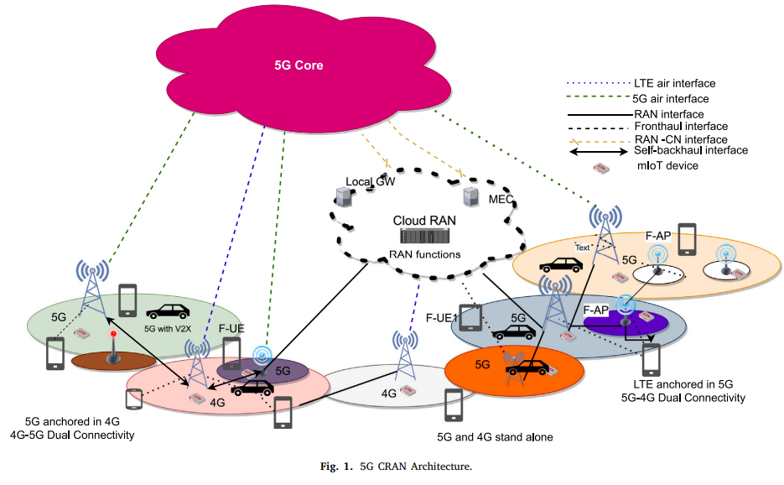
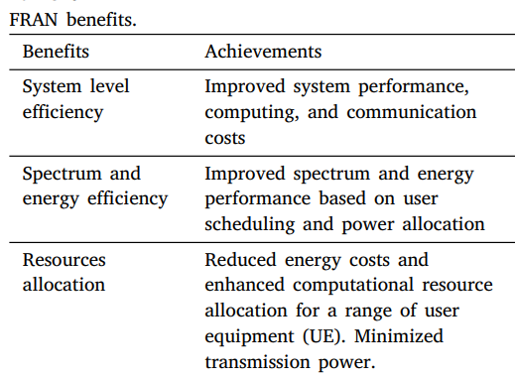
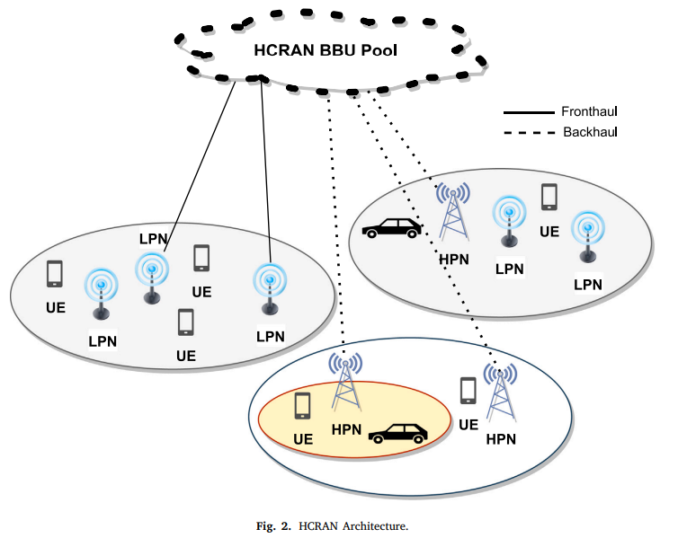
5G Radio Access Networks: A Survey
Link to the paper
TM
Methodology
The fifth generation (5G) technology is a major component of the Fourth Industrial Revolution (4IR), which supports the use of integrated spectrum with traditional technologies.5G aims at delivering enhanced mobile broadband (eMBB), massive machine-type communication (mMTC), and ultra-reliable and low-latency communication (uRLLC)..
Introduction
Results
Objectives
To provide enhanced user’s quality of experience (QoE) and satisfy vertical industrial requirements.
studying these RAN architectures from various perspectives such as energy and spectrum usage, CAPEX/OPEX, system level performance.
Conclusion
5G necessitates a complete rethinking of mobile network design, particularly the RAN architecture because of huge connectivity, massive data, and new expectations for extremely low latency and higher data rates. The goal was to explore the benefits of CRAN and HCRAN while not disregarding the challenges that each network design encounters. In the case of FRAN, a different method was followed, with the focus being on resource categories within the design layers and then an analysis of resource management system.
Requirements
1. CRAN splitting the BS into BBU and RRH.
2. Need for dense 5G RANs
3. Improving QoS for end users.

Slide 11
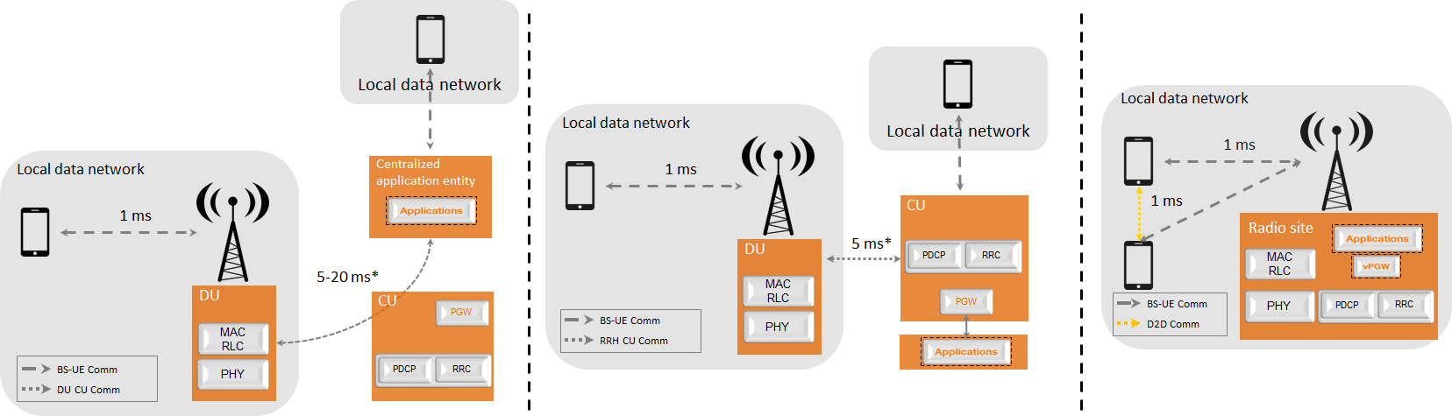
5G Ran For Verticals: Challenges And Enablers
Link to the Paper
TM
Methodology
5G networks involve the so-called enhanced Mobile Broadband (eMBB) service, along with this the 5G design has to meet the requirements of two “new” mobile services: massive Machine Type Communications (mMTC), characterized by a very large density of connected objects and Ultra-Reliable Low Latency Communications (URLLC), characterized by stringent requirements in terms of low latency and high reliability.
Introduction
Results
Slicing is expected to facilitate openness of the network to third parties, or tenants (e.g., a virtual network operator or a vertical). Openness of the network to third parties is regarded as a key issue as it may encourage some vertical players to use operators’ networks and thus it raises several issues against the third parties on the global performance of the network.
Slice monitoring has to report Key Performance Indictors (KPI) that are user-related (throughputs, delays, reliability), but also network-related (per slice load and energy efficiency). The latter KPIs are challenging to assess as they are related to the infrastructure that is shared between slices.
Objectives
Identifying the plausible options for implementing slicing concept at the RAN level to respond to needs of verticals.
Satisfying the RAN slicing for meeting the heterogeneous service requirements while sharing the same radio and processing resources.
(a) URLLC slice with very stringent latency
constraints (e.g. industrial control). Virtual
PGW (vPGW) and applications are in the
radio site.
(b) Wide area coverage slice with distant
applications (e.g., eMBB), while the Packet
Gateway (PGW) is in the CU.
Conclusion
This paper has investigated slicing concept in the 5G RAN, plausible options for slicing concept at the RAN level to respond to needs of verticals. While the lower layers need not know exact ID of slice, they should respond to their heterogeneous requirements. Different concepts, challenges related to RAN slicing and their management have been described. The tiling concept allows implementing different PHY/MAC configurations on the same spectrum, slice management entity maps slices to tiles at a relatively long time scale.
Requirements
Slicing Granularity at the RAN
Slice isolation and spectrum sharing
Tiling and Scheduling
Puncturing concept for URLLC scheduling
Slice identification and mapping
Architectural considerations
Slice – specific configurations
Resource Allocation
SLA Monitoring
(c) Slice with regional footprint and medium
sensitivity to latency (e.g., augmented reality).
Both applications and PGW are in the CU.

Slide 12
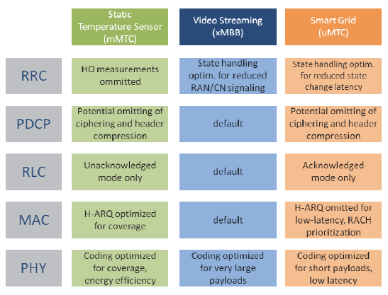
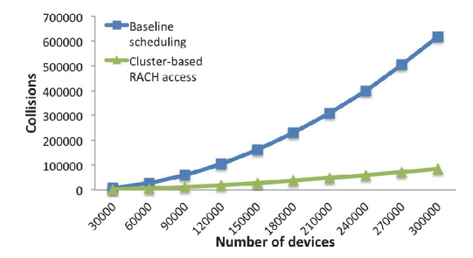

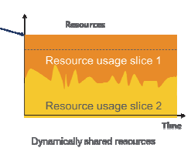
Impact of Network Slicing on 5G Radio Access Networks
Link to the paper
TM
Methodology
Network slicing is an important part of the NGMN’s vision for the overall 5th Generation (5G) architecture that addresses the deployment of multiple logical networks as independent business operations on a common physical infrastructure. The ultimate goal is to provide “network slices on an as-a-service basis” and also meet address the needs of different 5G use cases with highly diverging requirements.
Introduction
Results
Objectives
To contribute to the RAN design by analyzing the requirements needed to support network slicing.
To identifies parts of the RAN that will most likely to be affected by this network slicing requirements.
Fig. Example of how service-tailored random access optimization can be beneficial in mMTC using cluster based access
Conclusion
Requirements
Fig. Example of service-tailored optimization for different slices.
The paper presented a set of requirements to guide the 5G RAN design in order to support the concept of network slicing. These requirements should drive the design of a common protocol architecture supporting multiple slices and services, but allowing slice-tailored optimizations and NFs usage. The most efficient way to realize and/or standardize this common architecture is still under investigation.
Maximum utilization of RAN resources
RAN should be made slice-aware
Support mechanisms for traffic differentiation
RAN should support protection mechanisms
RAN should support infrastructure management
Protocol architecture
Design of Network Functions(NFs)
Network management
Impacts
Fig. One way to make RAN slice-aware is via a Slice-ID.

Slide 13
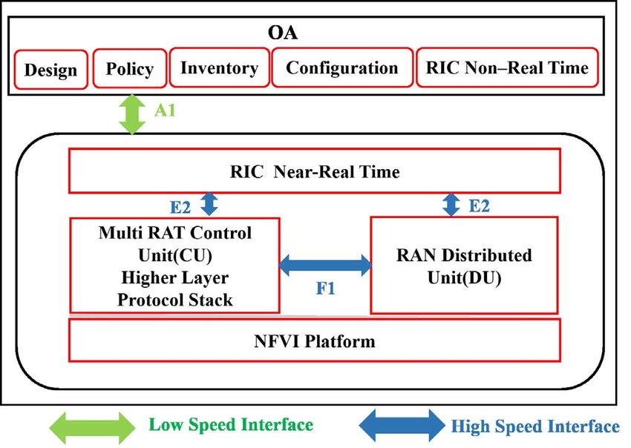
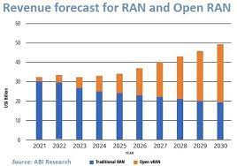
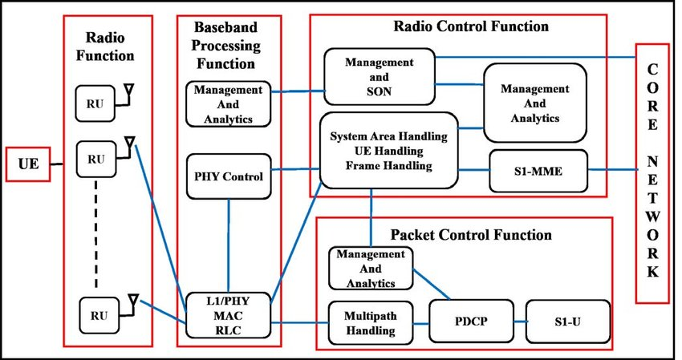
Impact of O-RAN on 5G Radio Access Networks
Link to the paper
TM
Methodology
Open Radio Access Network(O-RAN) is being considered as the most viable solution for next generation RAN. The advent of O-RAN is a step towards the software oriented infrastructure which enables the network to behave differently according to the QoS requirement of the processed application. It creates a chance for the small vendors to start their own services and to increase their market revenue
Introduction
E
Results
Objectives
To make the mobile network more software driven, virtualized, flexible, intelligent and energy efficient.
To make the network cost efficient and reliable.
Fig1.Reference Architecture of O-RAN
Fig 3.Revenue Forecast of O-RAN
Conclusion
Requirements
Modern applications require a flexible network which leads to the emergence of building up a standard open interface enabled by AI based network function virtualization. The architecture given in this work is a step towards software oriented network. The co-existence of variety of applications require flexible, application oriented and adaptive network which are difficult to support on the existing infrastructure.
Disaggregation enables each unit to perform specific functions and thus, adds flexibility in the network.
Responsible for signal amplification and regeneration Support mechanisms for traffic differentiation.
Impact
Radio Functions at RU
Baseband Processing Function
Radio Control Functions
Packet Switching Functions
Fig. One way to make RAN slice-aware is via a Slice-ID.
Fig 2.Expanded version of future RAN

Slide 14
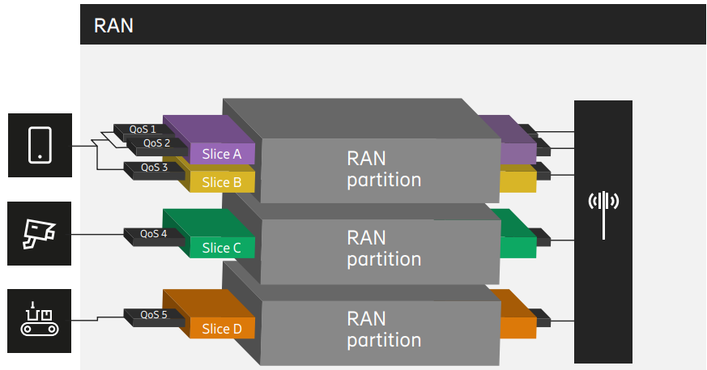
Proposed System
Dynamic RAN Slicing Environment in 5G

Slide 15
Functional and Non-Functional Requirements
Functional requirements
The network shall offer tailored solutions for each slice.
The network slices shall be completely isolated from each other.
The network shall get sliced dynamically according to requirements.
Non-Functional requirements
The network should have latency less than 10ms.
The network should allow a maximum of eight slices.
The network should be able to offer data speed more than 1000mbps

Slide 16
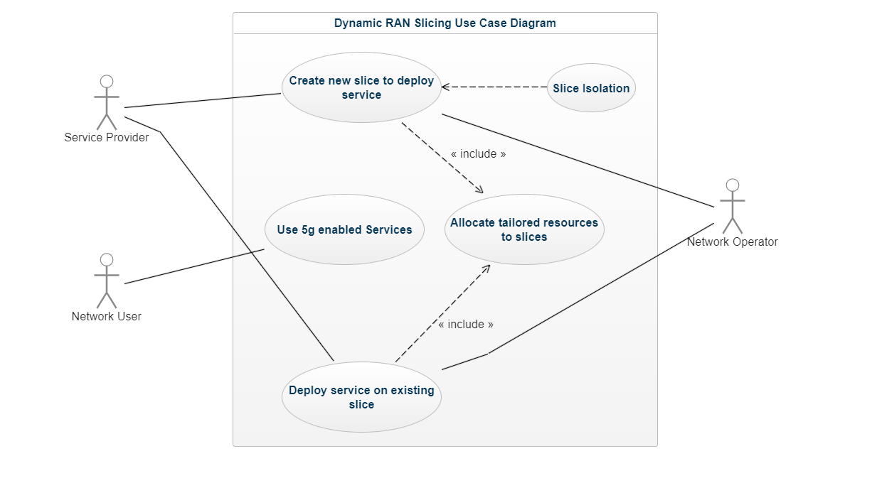
Use Case Diagrams
<< extend>>

Slide 17
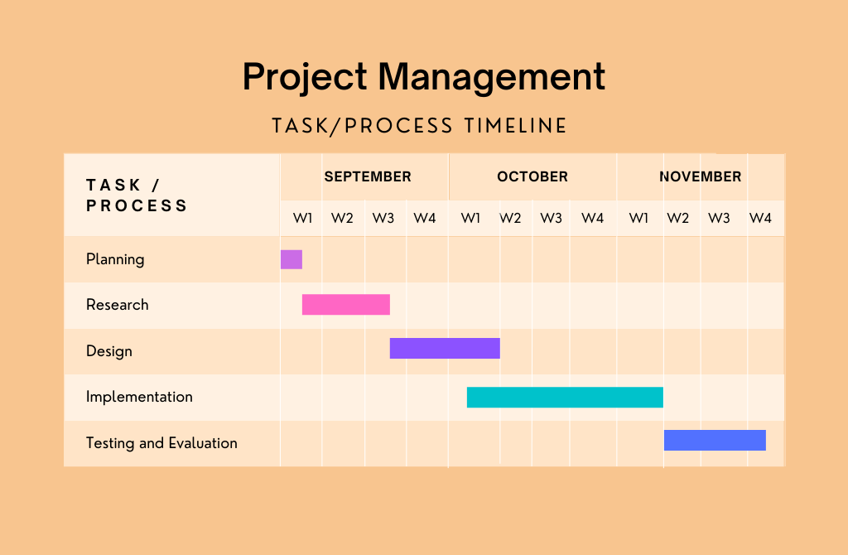
Timeline

Slide 18
THANK YOU

